Slide 1
Neural Caption–Image Retrieval
Machine Learning Mini Project- UE24CS352A
NAME: TATAM MAHALAKSHMI, TS SATHYA KIRAN
SRN: PES2UG24CS558, PES2UG24CS547
FACULTY: DR.PREMA
SECTION: I

Slide 2
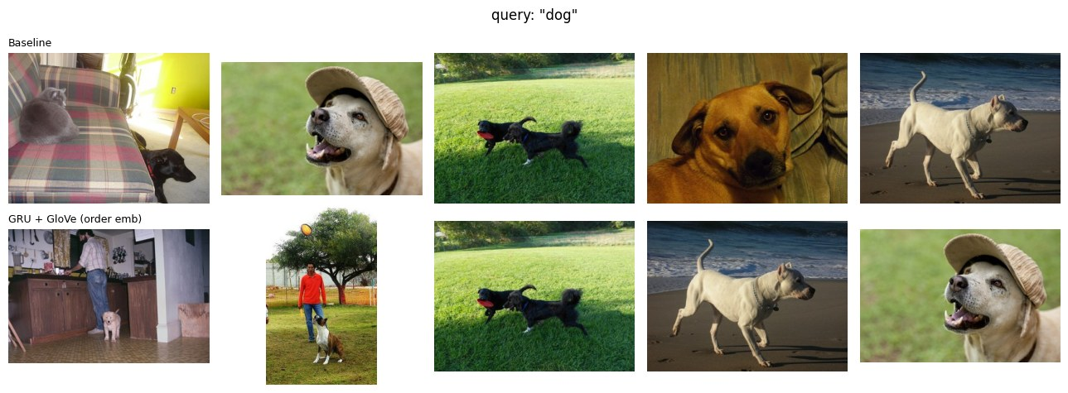
Problem Statement
Goal
Given a natural language caption,
retrieve the most relevant image from a gallery of images.
Instead of generating captions,
our model searches for images
that best match the input text.
Applications
Insert Icons
Image Search
E-commerce
Social Media

Slide 3
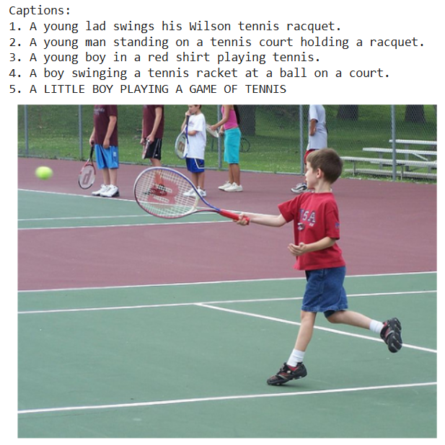
Dataset
Dataset Used
MS COCO 2017
Microsoft Common Objects in Context
Every image has 5 captions
Images contain everyday scenes
Widely used benchmark
Training 40,000
Validation 500
Testing 1,000
Queries 5,000

Slide 4
Methodology
Input Image
Input Caption
VGG-19 Feature Extractor
GloVe Word Embeddings
Linear Layer
GRU Encoder
Shared 1024-D Space
Cosine Similarity
Top-5 Retrieved Images

Slide 5
Workflow:
Input image is processed by VGG-19.
Image features are extracted.
Text captions are encoded using GRU with GLoVe embeddings.
Image and text embeddings are mapped into a shared feature space.
Cosine similarity is computed.
Top matching images are retrieved.

Slide 6
Training Process
Training Data:
  40,000 image-caption pairs from the MS COCO 2017 dataset.
Ranking Loss:
  The model learns by bringing each caption closer to its correct image than to other images.
Batch Training:
  Each training batch contains 128 image-caption pairs.
Similarity Functions:
  Two similarity methods were evaluated:
  Normal Distance
  Order-Embedding
Training Settings:
  Adam Optimizer
  Learning Rate = 0.0002
  Batch Size = 128
  Dropout = 0.2
  Maximum 25 epochs
  Early stopping after 5 epochs without improvement.

Slide 7
Models Compared
Model | Description
Baseline | Ridge Regression + Mean GloVe
GRU | Random Word Embeddings
GRU + GloVe | Pretrained GloVe Embeddings
LSTM + GloVe | LSTM Encoder
GRU + GloVe + Order Embedding | Final Best Model

Slide 8
Evaluation Metrics
Performance Metrics
Recall@1 (R@1): Correct image appears in the top 1 result.
Recall@5 (R@5): Correct image appears in the top 5 results.
Recall@10 (R@10): Correct image appears in the top 10 results.
Median Rank (MedR): Median rank of the correct image (lower is better).
Mean Rank (MeanR): Average rank of the correct image (lower is better).
Higher Recall values indicate better retrieval performance,
while lower Mean Rank and Median Rank indicate better accuracy.

Slide 9
Results
Method | R@1 | R@5 | R@10 | MedR | MeanR
Baseline (ridge on mean GloVe) | 4.4 | 13.7 | 20.6 | 82.0 | 190.1
GRU (random init) | 30.3 | 64.6 | 79.5 | 3.0 | 11.4
GRU + GloVe | 29.5 | 65.1 | 80.4 | 3.0 | 10.2
LSTM + GloVe | 31.1 | 66.2 | 80.3 | 3.0 | 10.2
GRU + GloVe (order emb) | 32.3 | 67.1 | 80.7 | 3.0 | 9.7
Highlighted row: best model, chosen on validation R@10.
GRU + GloVe (order embedding) achieved the best performance with R@10 = 80.7%.
The neural models significantly outperformed the baseline (80.7% vs 20.6% R@10).
The best model also achieved the lowest Mean Rank (9.7), indicating more accurate image
retrieval.

Slide 10
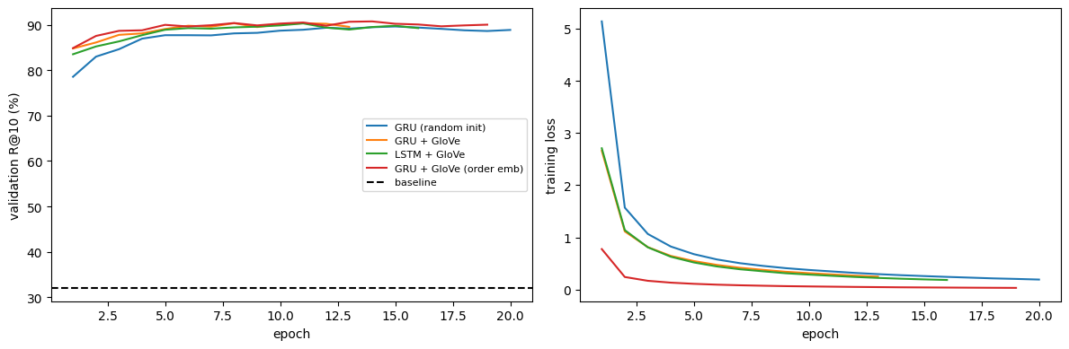
Left: validation R@10 per epoch for each variant; dashed line is the ridge baseline. Right: training loss
All neural models achieve over 80% validation R@10 within the first few epochs.
GloVe-initialized models start with better performance than random initialization.
Training loss decreases steadily, indicating successful model convergence

Slide 11
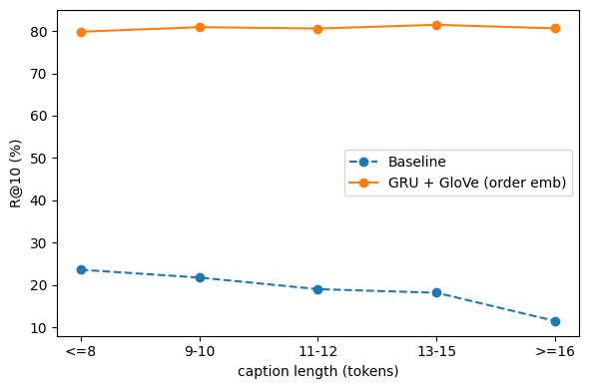
Analysis
Key Observations
Neural model maintains 80–82% R@10 across all caption lengths.
Baseline performance drops from 24% to 11% as captions become longer.
GRU captures word order better than averaging word vectors.
Results are consistent with the reference paper.
R@10 by caption length for the baseline and the best neural model.

Slide 12
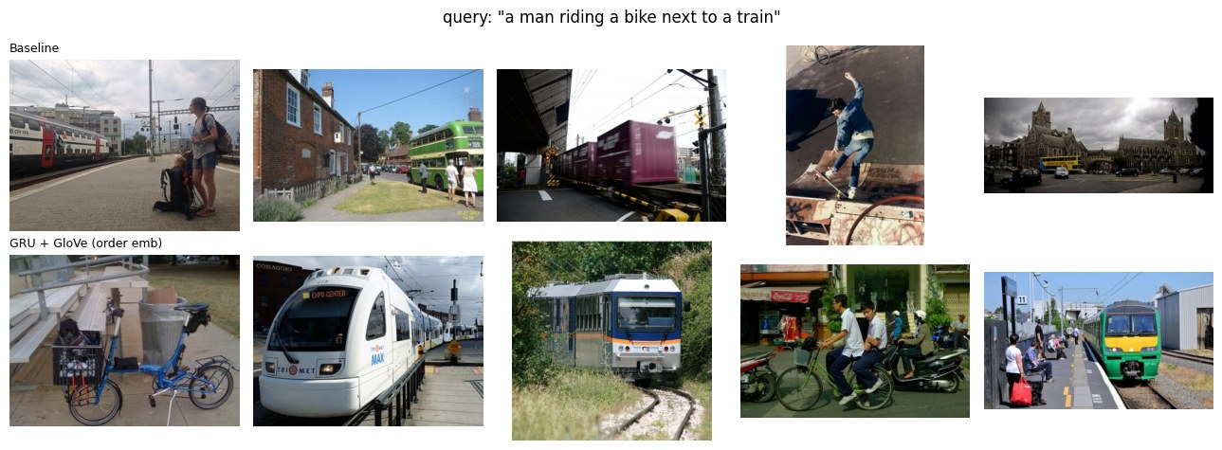
Example Query: "a man riding a bike next to a train“
Neural model retrieves images containing both bike and train.
Baseline misses the bike and returns weaker matches.
Demonstrates better semantic understanding by the neural model.

Slide 13
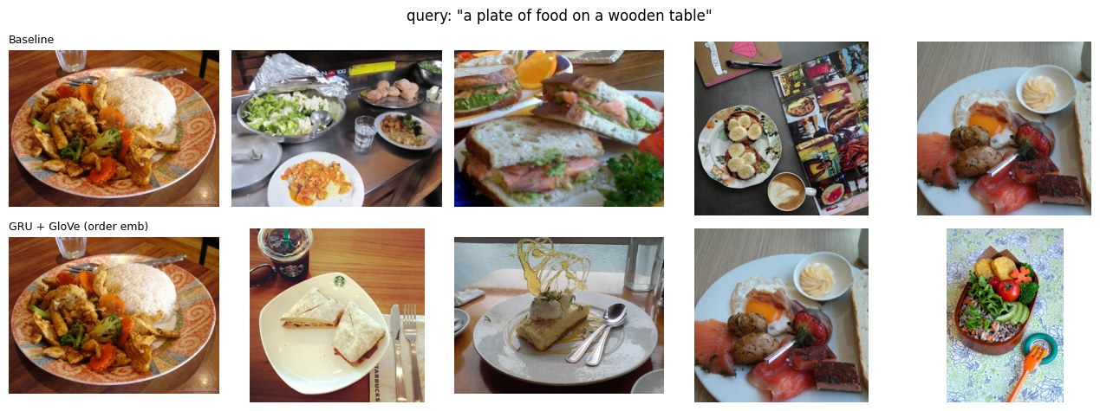
Both models successfully retrieve food-related images for the given query.
The neural model returns more relevant matches, including plates on wooden tables.
This demonstrates that the neural model captures image-caption semantics better than the
baseline.

Slide 14
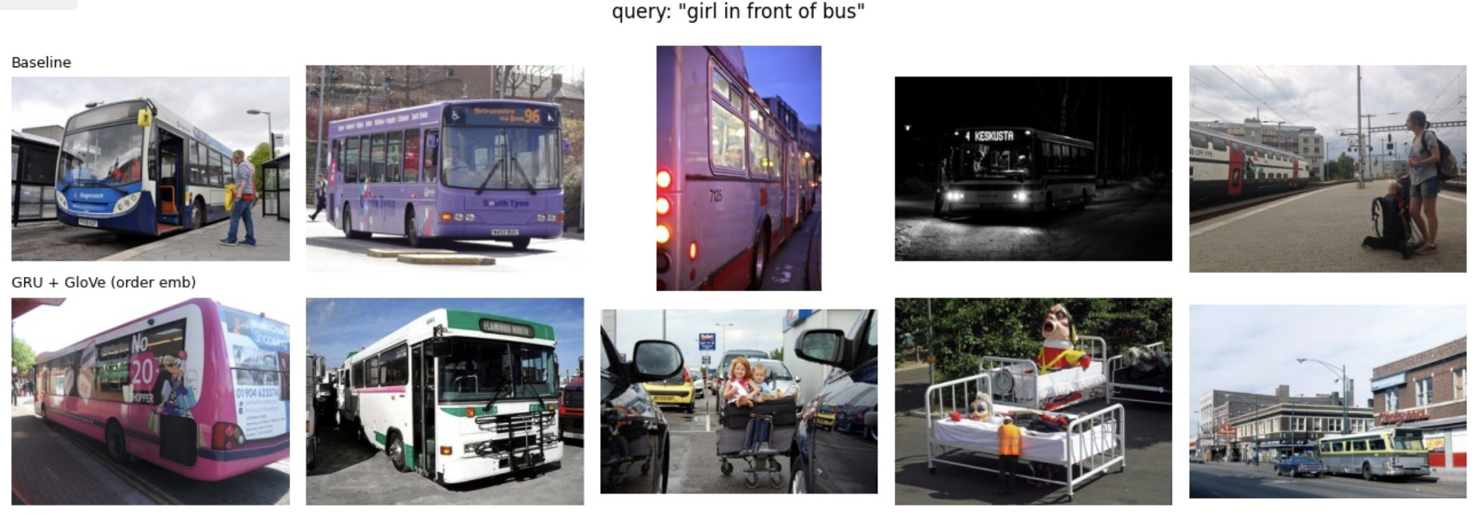
Limitations

Slide 15
Trained on 40,000 COCO images, not the full 118,000.
VGG image features are frozen and use a single center crop.
One run per variant, so the small differences between neural variants are within noise.
Relations like "in front of" and rare words are handled poorly (Figure 6).
Gallery is only 1,000 images, so queries for objects absent from it return the closest wrong results.
Absolute numbers are below the reference paper's (86.8% vs 80.4% R@10 for GRU + GloVe), as expected with about a third of the training data.

Slide 16
Conclusion
The neural models performed significantly better than the baseline. The best model (GRU + GloVe with Order Embedding) achieved 80.7% R@10 and 32.3% R@1, compared to 20.6% and 4.4% for the baseline. The median rank also improved from 82 to 3.
The four neural models showed very similar performance (79.5%–80.7% R@10). Since each model was trained only once, the small differences between them cannot be considered significant.
GloVe initialization helped the model learn faster during the early training stages, but the final improvement over random word vectors was small (+0.9% R@10).
The neural model maintained consistent performance across captions of different lengths, while the baseline's accuracy decreased for longer captions because averaging word vectors loses important contextual information.
Although the model performs well on common objects and scenes, it still struggles with complex spatial relationships (such as "in front of") and rare words. Future improvements include training on the full COCO dataset, using attention mechanisms, and fine-tuning the image encoder.

Slide 17
LIVE DEMO
Demo Queries
🚲 a man riding a bike next to a train
🐶 A man riding a bike next to a train
🍽️ A plate of food on a wooden table

